Slide 1
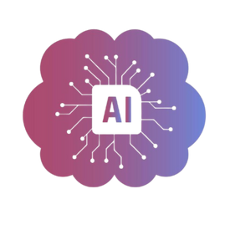
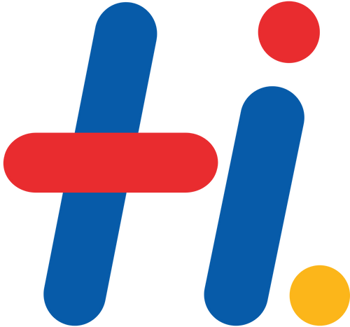
AgentsInAction Hackathon
Team Name - Synkron Knights
Team members :
Karthikram Prabhakar
Hemashri S
Keerthika R
Sai Vighnessh B L

Slide 2

Problem Statement
HTPS - Cross Jurisdictional Legal Real Time Risk Modeling
(More Legal)

Slide 3

Synkron Knights
The reason to name the agents as Synkron Knights is: The word Synkron denotes ‘synchronization of information’ and the word Knights denote ‘law protectors’. The purpose is to sync the latest legal information across countries and to provide optimal decision making support, with better legal practices.

Slide 4
Need of Synkron Knights
Businesses operating across countries face changing and conflicting laws, and manual interpretation of complex legal texts often causes delays, inconsistent decisions, and increased risk of fines and compliance failures.
Synkron Knights is an AI-powered Legal Risk Intelligence system designed to analyze unstructured business or regulatory text and provide a clear, actionable risk assessment.
The solution converts complex regulatory analysis into plain-English insights, reducing manual legal effort and ensuring consistency in risk evaluation.

Slide 5





Case Study of Meta
Haha,. I could’ve used that in 2018!
Hey Mark! Agents like Synkron can help companies make smarter legal decisions… so they don’t get into trouble!
Did you know?
Meta was fined over €1.2 billion by EU regulators for transferring EU user data to the US without proper safeguards.

Slide 6
Existing System
Tools like Regology, LexisNexis, Xapien and Westlaw mainly provide legal information, but users must still interpret and decide manually.
Compliance platforms such as OneTrust, ServiceNow GRC, and MetricStream rely on fixed rules and checklists, making them slow and ineffective when laws change or overlap across countries.
These systems cannot directly analyze real business scenarios to determine actual risk.

Slide 7
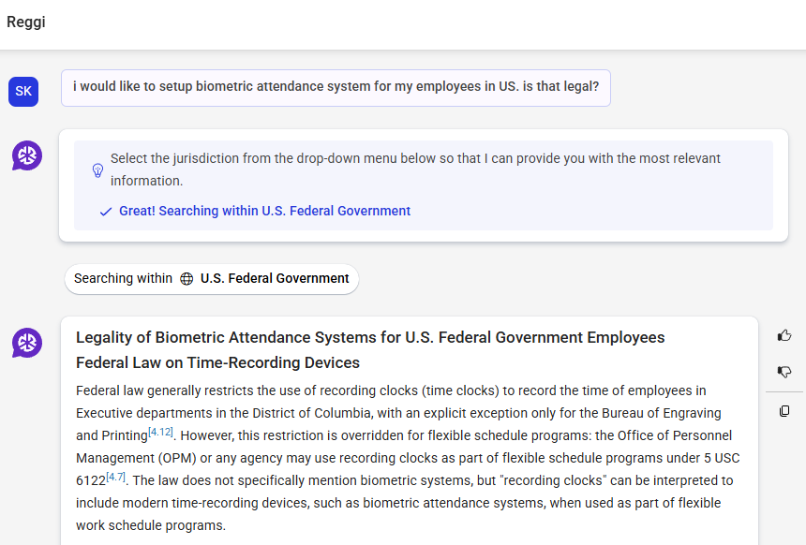
Existing System
Sample screenshot of Reggi

Slide 8
What’s the difference??
While existing tools provide legal information or guidance, Synkron Knights focuses on applying a consistent and repeatable analysis process to assess legal risk in real business scenarios. It follows a fixed analysis process to understand a business scenario, identify applicable laws across countries, assign a risk score, and give a clear business decision.
This makes legal risk assessment faster, repeatable, and reliable instead of opinion-based.

Slide 9
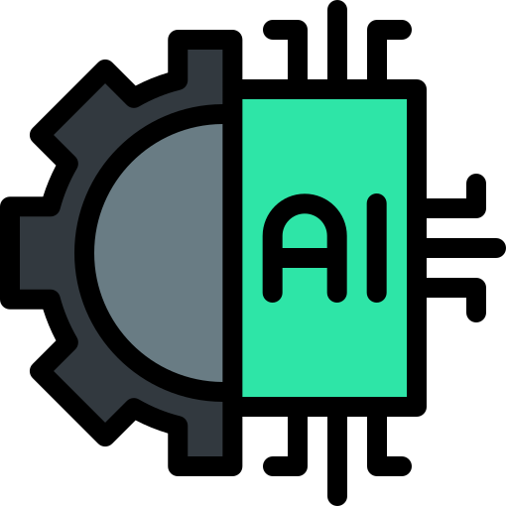
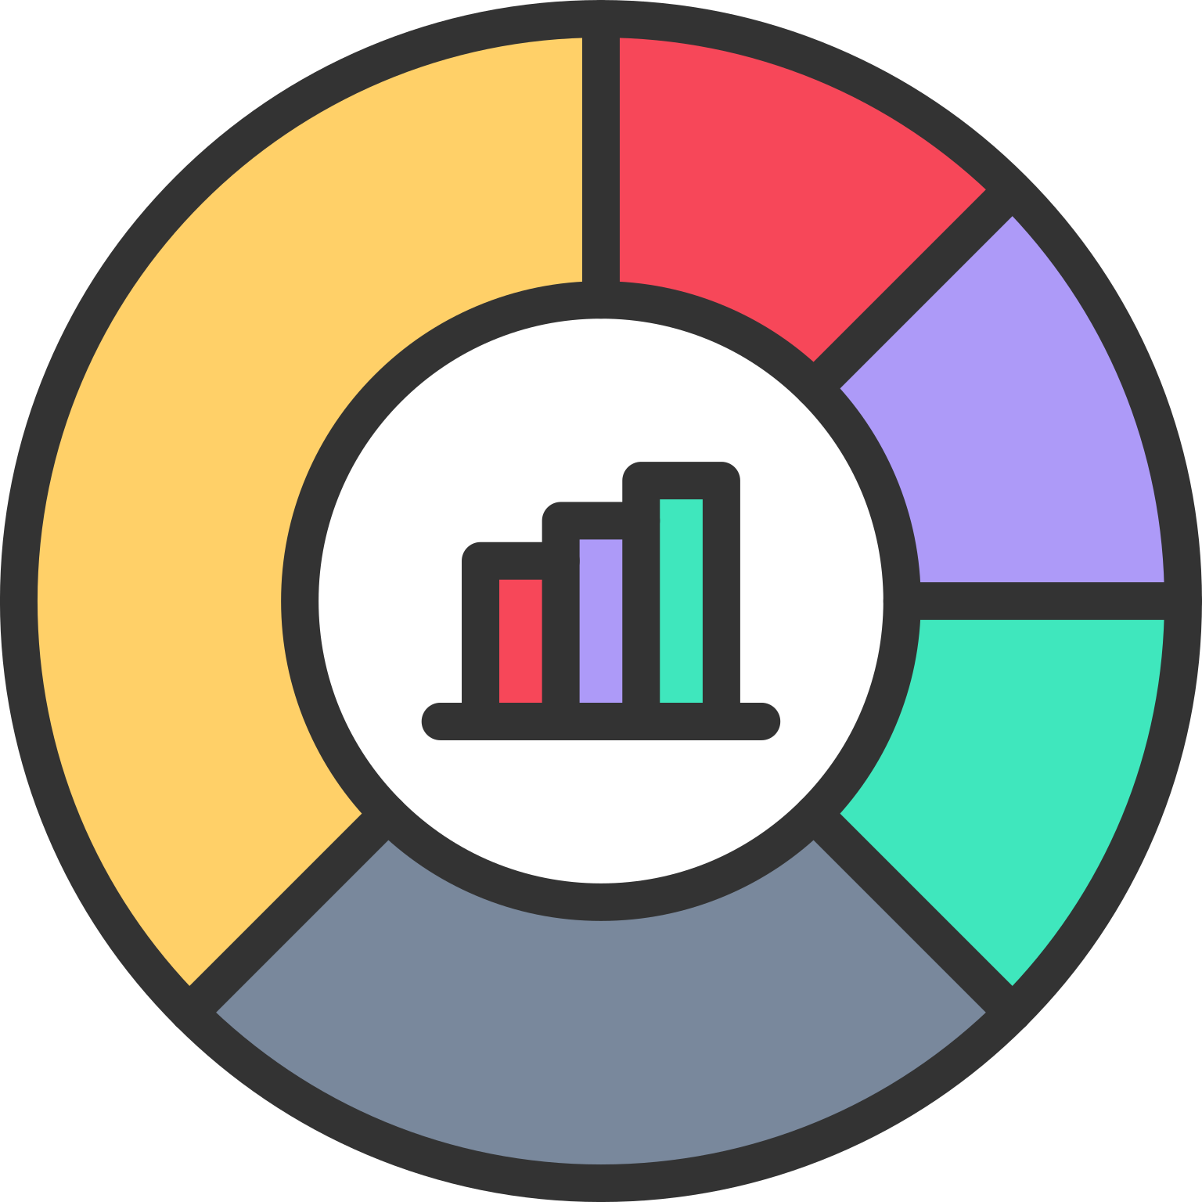
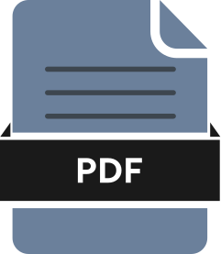
What’s in our Prototype?
A working AI-based Legal Risk Intelligence Agent
Dashboard covering insights.
Exportable Analysis(as .pdf)

Slide 10


Flow of Synkron Knights
User enters business scenario text as input.
Frontend sends text to backend.
Backend preprocesses input text.
Agent analyzes risks using provided prompt logic.
Risk score and compliance decision are generated.
Final response is formatted into readable output.
Result is displayed on the dashboard.

Slide 11
Demonstration

Slide 12
Future Implementation Ideas
As of now, Synkron Knights has been created as a minimal but effective prototype that can make a difference in decision-making.
In the future, we plan to incorporate the following ideas into the existing prototype:
  Real Time monitoring of Regulatory changes.
  Chatbot for continuous legal assistance and support.
  Business Impact Mapper.
  Past Case Outcome Intelligence.
  Early-Warning Risk Signals.

Slide 13
Learnings & Key Takeaways

Slide 14

print("Thank you for your time 🙂")

